Slide 1
BUDT703 Database Management Systems Team Project
Team Name: TrackWise Solutions
Team Members: Manasvi Surasani, Prakruthi Kaganti Shivakumar, Harini Gaddam, Linda Tom
Date: 6 December 2024

Slide 2
Table of contents
01
02
Background & Introduction
Database
Design
03
04
Business Transactions
Findings

Slide 3
Background
Users:
Amtrak Operations, Finance, HR, Strategy and Leadership Teams
Data and Data Sources:
Amtrak website (https://www.amtrak.com/):
State Factsheets
(https://www.amtrak.com/about-amtrak/amtrak-facts/state-fact-sheets.html)
Train routes
(https://www.amtrak.com/train-routes)

Slide 4
Introduction
Mission statement:
To analyze data on budget, on-time performance, ridership, guest rewards, procurement, and employment to obtain insights on driving operational excellence across Amtrak’s network

Slide 5
Mission Objectives
01
02
03
04
To identify the top ten cities with the highest ridership to prioritize resource allocation.
To determine the top ten states with the largest year-over-year increase in guest reward enrollments to focus customer engagement efforts in regions with growing loyalty.
To identify the top ten states with the highest operational efficiency, (based on on-time performance and staffing ratios) creating benchmarks for other states.
To categorize routes according to their on-time performance to identify routes that can be used as benchmarks for improving the performance of other routes

Slide 6
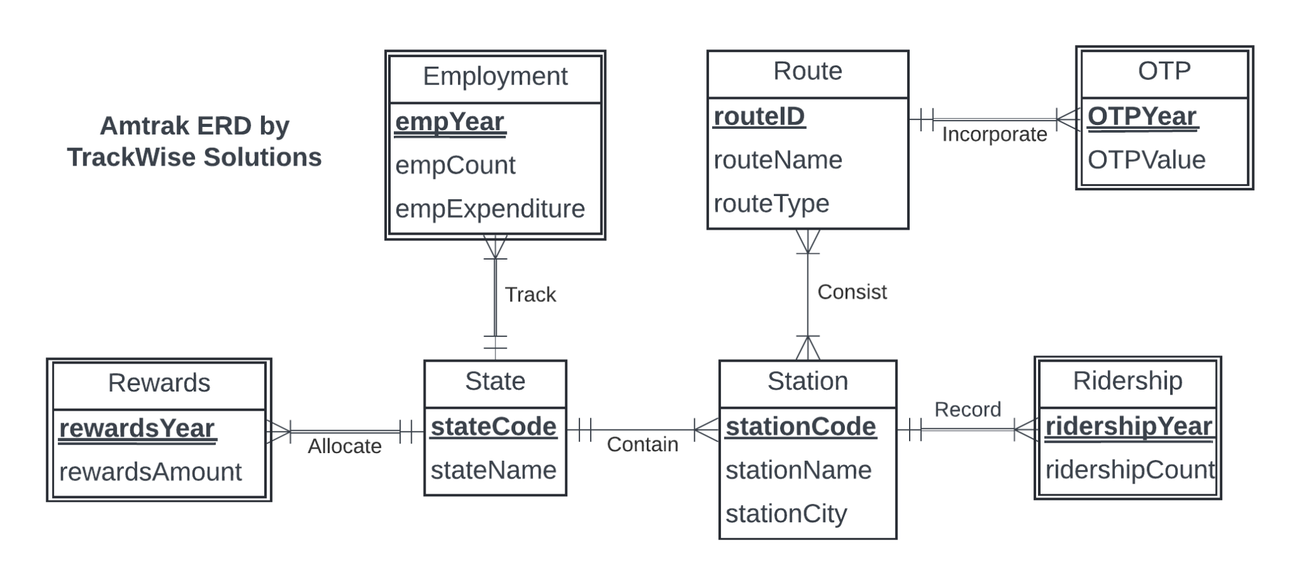
Conceptual Database Design

Slide 7
Logical Database Design
State(stateCode, stateName)
Rewards(stateCode, rewardsYear, rewardsAmount)
Employment(stateCode, empYear, empCount, empExpenditure)
Station(stationCode, stationName, stationCity, stationStateCode)
Consist(routeID, stationCode)
Route(routeID, routeName, routeType)
OTP(routeID, OTPYear, OTP)
Ridership(stationCode, ridershipYear, ridershipCount)

Slide 8
Physical Database Design
USE BUDT703_Project_0507_11;
DROP TABLE IF EXISTS [Amtrak.Ridership]
DROP TABLE IF EXISTS [Amtrak.Consist]
DROP TABLE IF EXISTS [Amtrak.OTP]
DROP TABLE IF EXISTS [Amtrak.Route]
DROP TABLE IF EXISTS [Amtrak.Station]
DROP TABLE IF EXISTS [Amtrak.Employment]
DROP TABLE IF EXISTS [Amtrak.Rewards]
DROP TABLE IF EXISTS [Amtrak.State]
CREATE TABLE [Amtrak.State](
stateCode CHAR(2) NOT NULL,
stateName VARCHAR(55),
CONSTRAINT pk_State_stateCode PRIMARY KEY (stateCode));
CREATE TABLE [Amtrak.Rewards](
stateCode CHAR(2) NOT NULL,
rewardsYear INT NOT NULL,
rewardsMembers INT,
CONSTRAINT pk_Rewards_stateCode_rewardsYear PRIMARY KEY(stateCode, rewardsYear),
CONSTRAINT fk_Rewards_stateCode FOREIGN KEY(stateCode)
REFERENCES [Amtrak.State] (stateCode)
ON DELETE CASCADE ON UPDATE CASCADE);

Slide 9
Physical Database Design
CREATE TABLE [Amtrak.Employment] (
stateCode CHAR(2) NOT NULL,
empYear INT NOT NULL,
empCount INT,
empExpenditure DECIMAL(12,2),
CONSTRAINT pk_Employment_empYear_stateCode PRIMARY KEY (empYear,stateCode),
CONSTRAINT fk_Employment_stateCode FOREIGN KEY (stateCode)
REFERENCES [Amtrak.State](stateCode) ON DELETE CASCADE ON UPDATE CASCADE) ;
CREATE TABLE [Amtrak.Station](
stationCode CHAR(3) NOT NULL,
stationName VARCHAR(55),
stationCity VARCHAR(25),
stationStateCode CHAR(2) NOT NULL,
CONSTRAINT pk_station_stationCode PRIMARY KEY (stationCode),
CONSTRAINT fk_station_stationStateCode FOREIGN KEY (stationStateCode)
REFERENCES [Amtrak.State](stateCode)
ON DELETE NO ACTION ON UPDATE CASCADE);
CREATE TABLE [Amtrak.Route](
routeID CHAR(4) NOT NULL,
routeName VARCHAR(35),
routeType VARCHAR(20),
CONSTRAINT pk_Route_routeID PRIMARY KEY(routeID) );

Slide 10
Physical Database Design
CREATE TABLE [Amtrak.OTP](
routeID CHAR(4) NOT NULL,
OTPYear INT NOT NULL,
OTP DECIMAL(3,3),
CONSTRAINT pk_OTP_routeID_OTPYear PRIMARY KEY(routeID, OTPYear),
CONSTRAINT fk_OTP_routeID FOREIGN KEY (routeID)
REFERENCES [Amtrak.Route](routeID)
ON DELETE CASCADE ON UPDATE CASCADE);
CREATE TABLE [Amtrak.Consist](
routeID CHAR(4) NOT NULL,
stationCode CHAR(3) NOT NULL,
CONSTRAINT pk_Consist_routeID_stationCode PRIMARY KEY (routeID,stationCode),
CONSTRAINT fk_Consist_routeID FOREIGN KEY (routeID)
REFERENCES [Amtrak.Route](routeID)
ON DELETE CASCADE ON UPDATE CASCADE,
CONSTRAINT fk_Consist_stationCode FOREIGN KEY (stationCode)
REFERENCES [Amtrak.Station](stationCode)
ON DELETE CASCADE ON UPDATE CASCADE);
CREATE TABLE [Amtrak.Ridership] (
stationCode CHAR(3) NOT NULL,
ridershipYear INT NOT NULL,
ridershipCount INT,
CONSTRAINT pk_Ridership_ridershipYear_stationCode PRIMARY KEY (ridershipYear,stationCode),
CONSTRAINT fk_Ridership_stationCode FOREIGN KEY (stationCode)
REFERENCES [Amtrak.Station](stationCode)
ON DELETE CASCADE ON UPDATE CASCADE) ;

Slide 11
What are the top ten cities with maximum ridership?

Slide 12
SELECT OrderedCities.*
FROM (
SELECT s.stationCity AS 'Station City',
AVG(r.ridershipCount) AS 'Average Ridership',
RANK() OVER (ORDER BY AVG(r.ridershipCount) DESC) AS 'Rank'
FROM [Amtrak.Ridership] r, [Amtrak.Station] s
WHERE r.stationCode = s.stationCode
GROUP BY s.stationCity ) OrderedCities
WHERE OrderedCities.Rank <= 10
ORDER BY OrderedCities.Rank;

Slide 13
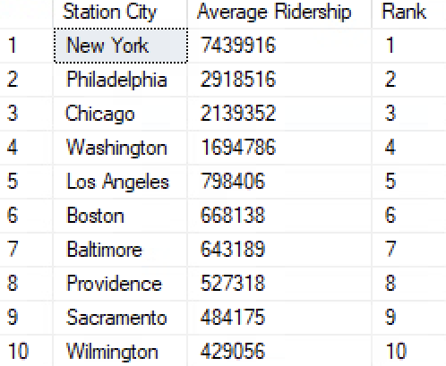

Slide 14
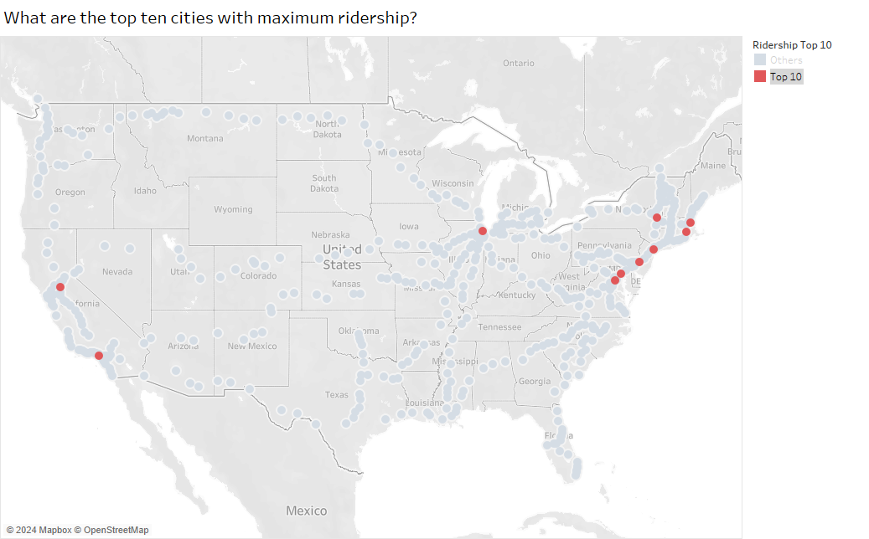

Slide 15
Which are the top ten states with the largest year-over-year percentage increase (and the corresponding absolute increase) in guest reward enrollments?

Slide 16
SELECT *
FROM (
SELECT RANK() OVER (ORDER BY (r2.rewardsMembers - r1.rewardsMembers)
*1.0 / r1.rewardsMembers DESC) AS 'Rank', s.stateName AS 'State Name',
r1.stateCode AS 'State Code', r1.rewardsYear AS 'Base Year',
r2.rewardsYear AS 'Comparison Year', FORMAT(CAST(((
r2.rewardsMembers - r1.rewardsMembers) * 1.0 / r1.rewardsMembers)
AS DECIMAL(10,4)), 'P') AS 'Percent Increase', CAST((r2.rewardsMembers
-r1.rewardsMembers) AS DECIMAL) AS 'Absolute Increase'
FROM [Amtrak.Rewards] r1
INNER JOIN [Amtrak.Rewards] r2 ON r1.stateCode = r2.stateCode AND r2.rewardsYear =
(SELECT MAX(rewardsYear) FROM [Amtrak.Rewards])
AND r1.rewardsYear = (SELECT MAX(rewardsYear) - 1 FROM [Amtrak.Rewards])
INNER JOIN [Amtrak.State] s ON r1.stateCode = s.stateCode
WHERE r1.rewardsMembers > 0 ) RankedResults
WHERE rank <= 10
ORDER BY 'Percent Increase' DESC;

Slide 17
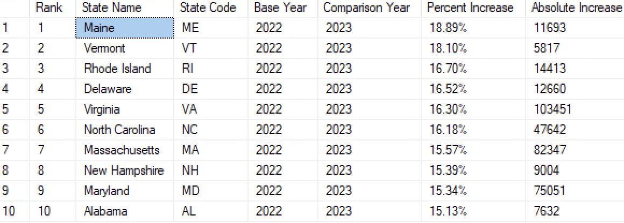

Slide 18
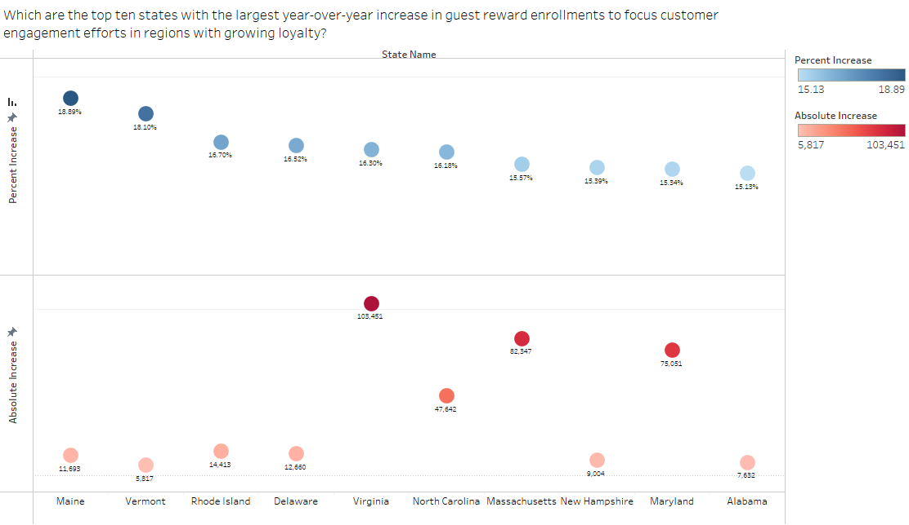

Slide 19
What are the top ten states with the highest operational efficiency score, based on normalized staffing ratio and on-time performance?

Slide 20
WITH StaffingRatio AS (
SELECT stateRidership.stateCode, stateRidership.totalRidership, stateEmp.totalEmployees,
CAST(stateRidership.totalRidership AS FLOAT) / CAST(stateEmp.totalEmployees AS FLOAT)staffingRatio
FROM (SELECT s.stationStateCode AS stateCode, SUM(r.ridershipCount) AS totalRidership
FROM[Amtrak.Station] s
JOIN [Amtrak.Ridership] r ON s.stationCode = r.stationCode
GROUP BY s.stationStateCode) stateRidership
LEFT JOIN (SELECT e.stateCode AS stateCode, SUM(e.empCount) AS totalEmployees
FROM [Amtrak.Employment] e
GROUP BY e.stateCode) stateEmp ON stateRidership.stateCode = stateEmp.stateCode),
AvgOTP AS (
SELECT st.stateCode, AVG(routeAvg.otpAvg) AS avgOTP
FROM [Amtrak.State] st
LEFT JOIN
(SELECT r.routeID,s.stationStateCode AS stateCode,
AVG(o.OTP) AS otpAvg
FROM [Amtrak.Route] r
JOIN [Amtrak.Consist] c ON r.routeID = c.routeID
JOIN [Amtrak.Station] s ON c.stationCode = s.stationCode
JOIN [Amtrak.OTP] o ON r.routeID = o.routeID
GROUP BY r.routeID, s.stationStateCode) routeAvg
ON st.stateCode = routeAvg.stateCode
GROUP BY st.stateCode),

Slide 21
NormalizedMetrics AS (
SELECT sr.stateCode, sr.staffingRatio, otp.avgOTP,
(sr.staffingRatio - MIN(sr.staffingRatio) OVER ()) /(MAX(sr.staffingRatio) OVER () - MIN(sr.staffingRatio) OVER ()) AS normalizedStaffingRatio,
(otp.avgOTP - MIN(otp.avgOTP) OVER ()) /(MAX(otp.avgOTP) OVER () - MIN(otp.avgOTP) OVER ()) AS normalizedOTP
FROM StaffingRatio sr
LEFT JOIN AvgOTP otp ON sr.stateCode = otp.stateCode)
SELECT RankedNM.[State Name], RankedNM.[Normalized Staffing Ratio], RankedNM.[Normalized OTP], RankedNM.[Operational Efficiency Score]
FROM (
SELECT NM.*, RANK() OVER (ORDER BY NM.[Combined Score] DESC) AS Ranking
FROM (
SELECT s.stateName AS 'State Name',
FORMAT(nm.normalizedStaffingRatio, 'N2') AS 'Normalized Staffing Ratio',
FORMAT(nm.normalizedOTP, 'N2') AS 'Normalized OTP',
FORMAT(nm.normalizedStaffingRatio + nm.normalizedOTP, 'N2') AS 'Operational Efficiency Score'
FROM NormalizedMetrics nm
LEFT JOIN [Amtrak.State] s ON nm.stateCode = s.stateCode
) NM
) RankedNM
WHERE RankedNM.Ranking <= 10
ORDER BY Ranking;

Slide 22
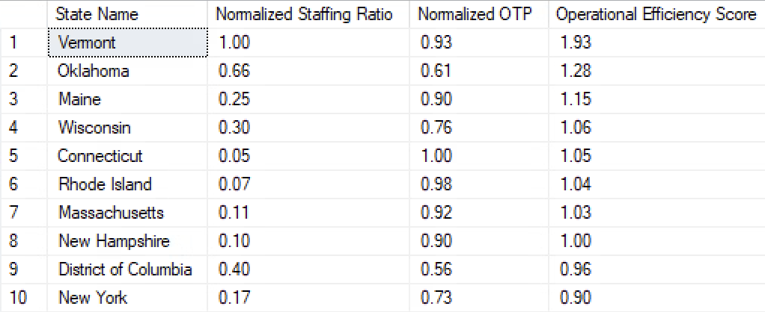

Slide 23
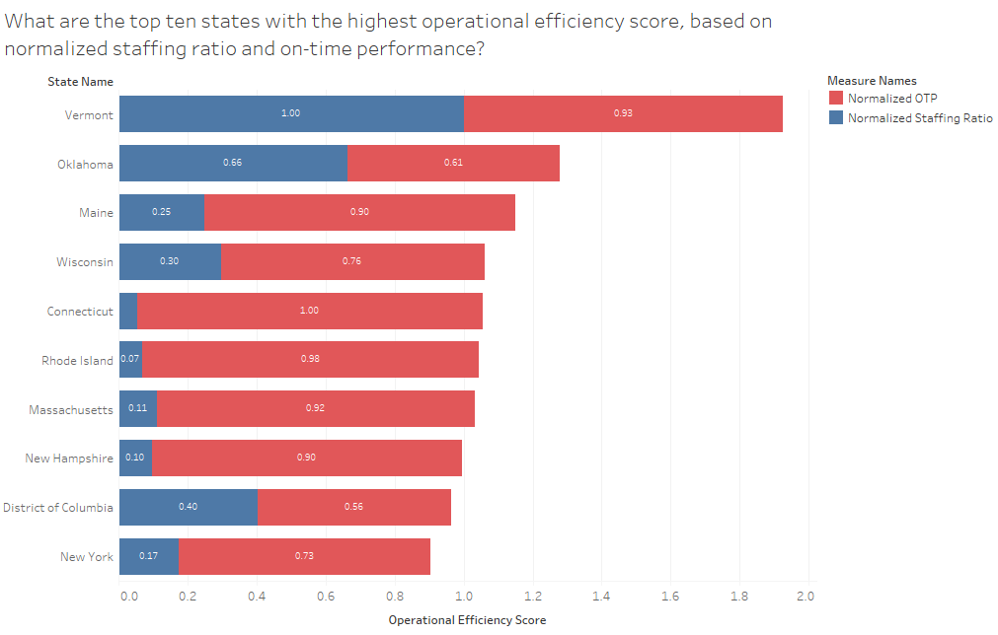

Slide 24
What are each route's categories (e.g. Low, Medium, High) based on their on-time
performance?

Slide 25
SELECT r.routeName AS 'Route Name',
FORMAT(AVG(o.OTP), 'P') AS 'Average OTP Percentage',
CASE
WHEN ROUND((AVG(o.OTP)*100),2) < 60 THEN 'Low’
WHEN ROUND((AVG(o.OTP)*100),2) < 85 THEN 'Medium’
ELSE 'High'
END AS 'Performance Category'
FROM [Amtrak.OTP] o
JOIN [Amtrak.Route] r ON o.routeID = r.routeID
GROUP BY r.routeName
ORDER BY 'Average OTP Percentage' DESC;

Slide 26
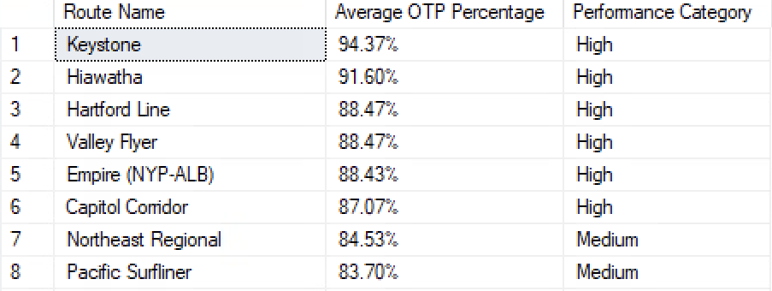
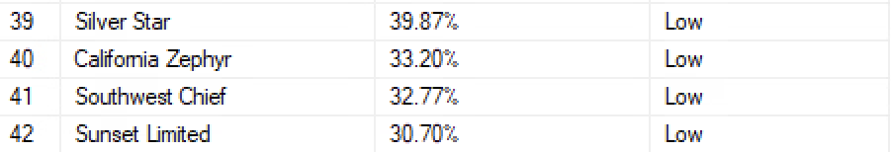

Slide 27
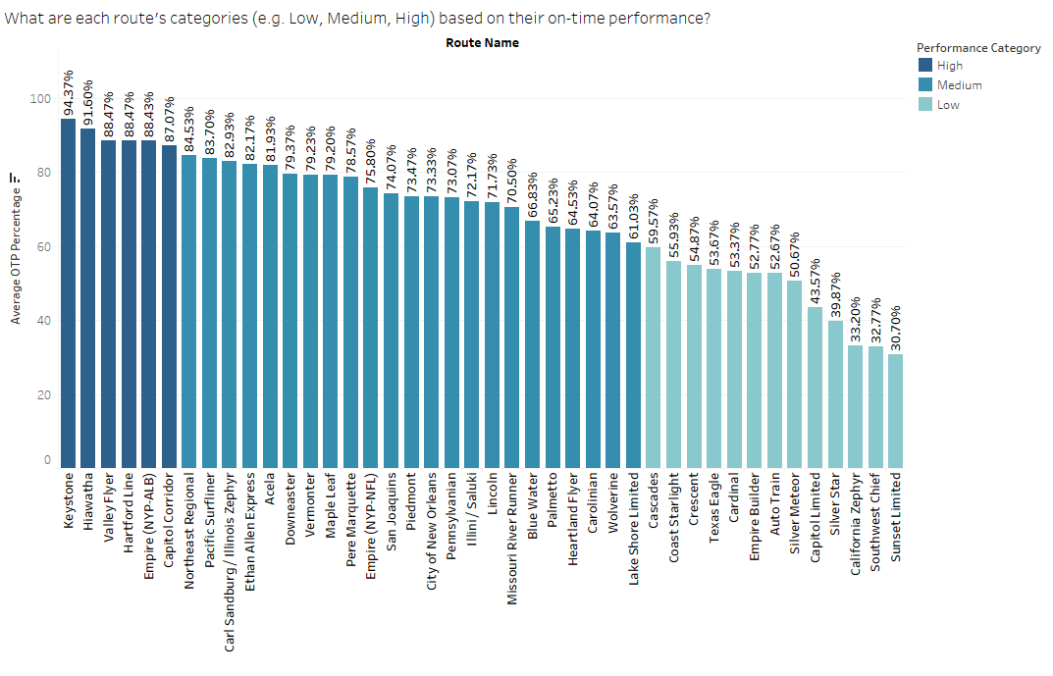

Slide 28
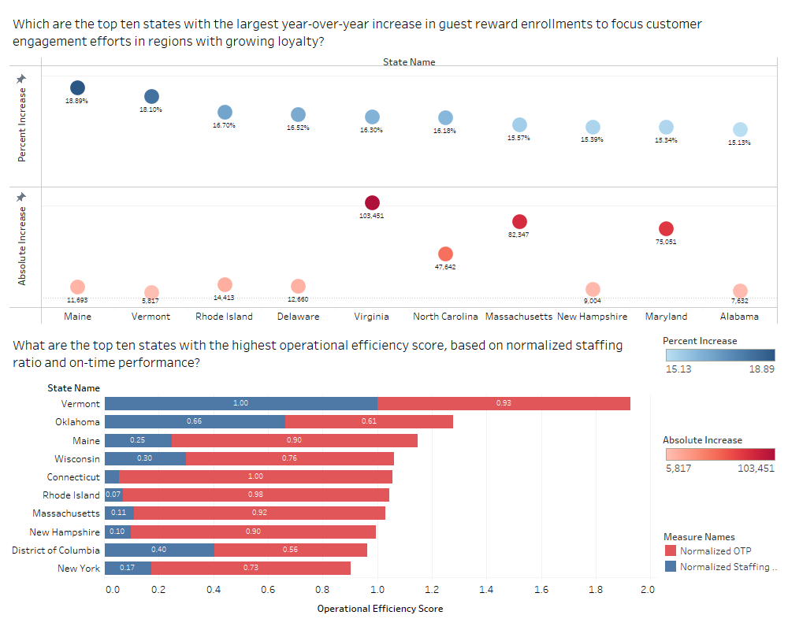
State Dashboard
Maine, Vermont, Rhode Island, Massachusetts, and New Hampshire stand out for excelling in both customer engagement and operational efficiency.
The strong performance in customer engagement (reward enrollments) aligns with their operational efficiency, suggesting a correlation between well-managed operations and higher customer loyalty.
For instance, Vermont's top operational efficiency score (1.93) likely supports its ability to deliver consistent, high-quality service, contributing to an 18.10% growth in reward enrollments.

Slide 29
Findings

Slide 30
Enhance Services in High Ridership Cities
Focus on improving infrastructure, services, and schedules in cities like New York, Philadelphia, and Chicago to cater to the high passenger demand
Consider analyzing lower tier cities and investigate the factors contributing to lower ridership and explore opportunities to increase passenger traffic.

Slide 31
Key Initiatives to Enhance Guest Reward Engagement
Invest in sustaining and further amplifying the success in Maine and Vermont through targeted loyalty programs and customer engagement initiatives.
States like Virginia and Massachusetts can serve as models for replicating large-scale engagement efforts in other regions.

Slide 32
Strategic Approaches to Improve Operational Metrics
Investigate the operational strategies employed by Vermont, as it leads in operational efficiency. Implement similar practices in other states to improve performance.
States like Connecticut and Rhode Island, which have high OTP but low staffing ratios, consider focusing on optimizing their staffing levels to enhance overall efficiency.
States like District of Columbia and New York need to improve their OTP and Staffing ratios to boost operational efficiency. Addressing the causes of delays and optimizing staffing levels with a balanced approach can help achieve higher operational efficiency.

Slide 33
Optimizing Resources for Underperforming Routes
Enhance communication with passengers, especially on routes with Medium and Low performance. Provide real-time updates and clear information about delays and expected arrival times.
The high-performing routes are primarily located in the Northeastern and Midwestern regions of the U.S., while the low-performing routes are concentrated in the Southwest and Southern parts.

Slide 34
Optimizing Resources for Underperforming Routes
To improve performance, it is crucial to allocate more resources and investment to these Southwest and Southern routes, which show the greatest potential for improvement. Focus on prioritizing infrastructure upgrades and implementing technology enhancements to drive better performance on these routes.

Slide 35
Thank you

